Slide 1
Box-office analysis between series and non-series movies
Chung-Hsuan Huang
7/23/2019

Slide 2
Outline
Motivation
Questions
Methods
Results
Summary and Future Work

Slide 3
Motivation
Nine out of the top ten grosses movies are sequels, live-action remakes or shared universe movies
Notes:
If we look at the number one worldwide gross movies since 1989, there are only three movies that are non-series movie.
Armageddon, Titanic, Ghost

Slide 4
Motivation
Nine out of the top ten grosses movies are sequels, live action remakes or shared universe movies
Notes:
If we look at the number one worldwide gross movies since 1989, there are only three movies that are non-series movie.
Armageddon, Titanic, Ghost

Slide 5


Questions
Do the numbers of series movie increase in the last 40 years?
Do a series movie make more profit than other movies?
How much profit does an original movie make?
What makes a successful series movie?
Notes:
If we look at the number one worldwide gross movies since 1989, there are only three movies that are non-series movie.
Armageddon, Titanic, Ghost

Slide 6
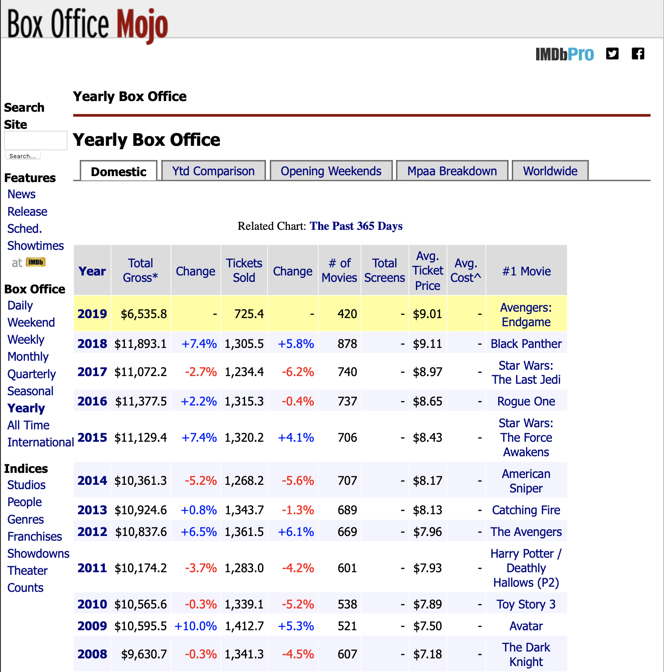
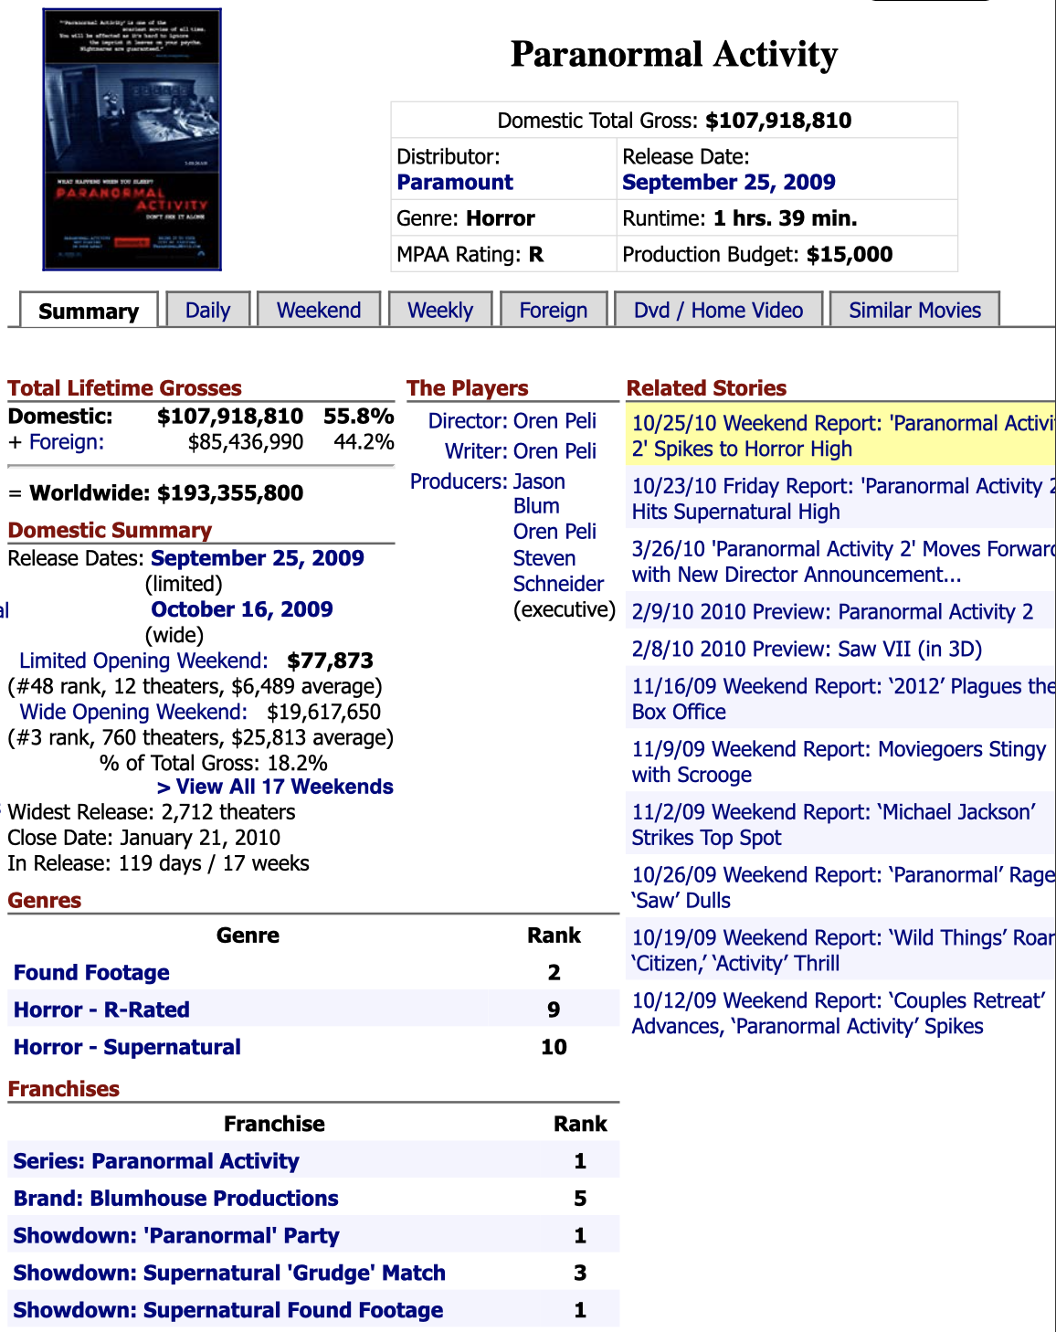
Methods
Data:
Top 100 domestic gross movie from 1982 – 2019 from boxofficemojo.com
Top 4000 movies ordered by production budget from the-numbers.com
The reviews of the first episode of the movie series from rottentomatoes.com

Slide 7
Results
Do numbers of series movie increase in last 40 years?
The numbers of series movie increase from 10 – 15 in 80s and 90s to 30 – 45 after 2010

Slide 8
Do series movie make more profit than other movies?
Number of total movies: 3797
Number of series movies: 762
Number of non-series movies: 3050
 | Series movie | Non-series movie
Mean | $180 million | $54 million
Median | $214 million | $55 million
p-value = 3.201507704954549e-140
10⁶: $1 million 10⁷: $10 million
10⁸: $100 million 10⁹: $1 billion
The difference in series and non-series movies worldwide gross are statistically different
Notes:
kernel density estimate
distplot

Slide 9
Do series movie make more profit than other movies?
How much profit does an original movie make?
 | Series movie | Non-series movie | The first movie of series movie
Mean | 4.29 | 2.45 | 5.33
Median | 3.18 | 1.56 | 3.87
Standard deviation | 3.57 | 2.98 | 4.60
p-value=1.2566244026357718e-28
Notes:
Two sample t-test

Slide 10
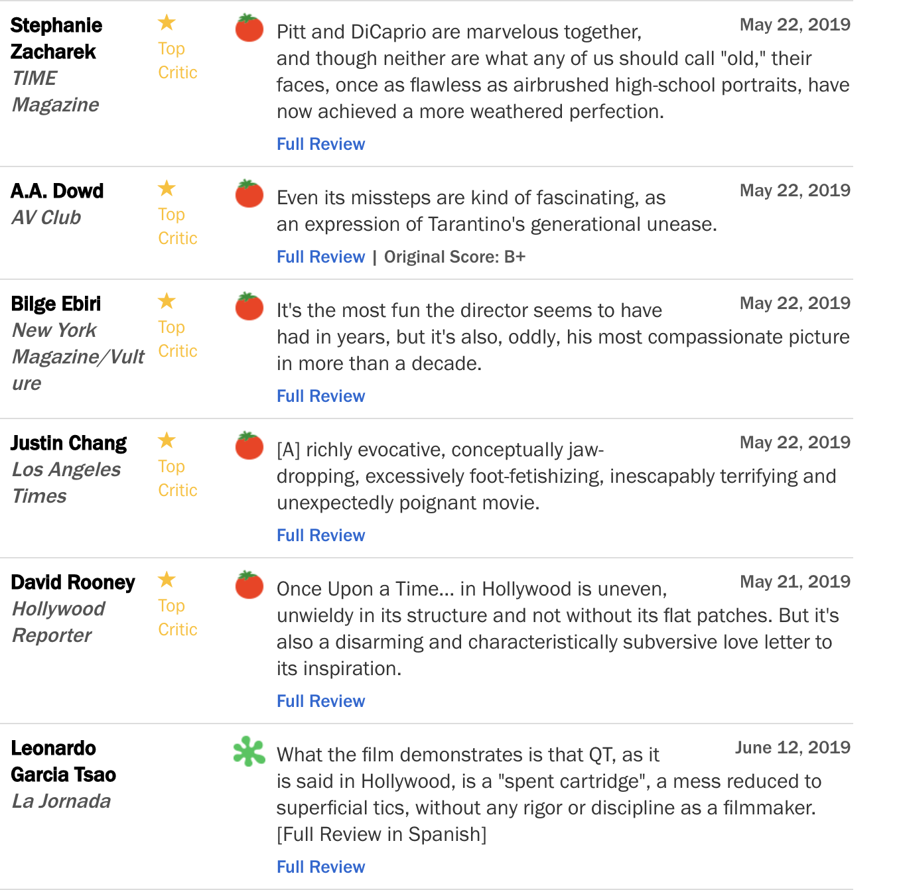
Key to make a successful original movie?
Scaping 10000+ review from the first movie of the movie series where their rotten tomatoes score are higher than 60
People (critics) are looking for a movie with a good story, characters, and having fun watching it
The context in the “Fresh” reviews are more positive, but the polarity of the “Rotten” review are evenly distributed
The reviews that are “Fresh”
The reviews that are “Rotten”
Notes:
Sentiment Analysis

Slide 11
Summary
Numbers of series movie increase in the last 40 years
Series movies are making more profit than non-series movies
If a movie makes a 500% profit, it might have a sequel or be remade in the future
A fun movie with good storytelling, the characters that can make bonding with the audience tends to have positive review and have potential to make good profit
Future work
Keep tracking the trend of series movies. When does audience get tired of them, or they never get tired?
Getting more comprehensive budget data to make analysis more accurate
Find other key features that make a movie success

Slide 13
Do series movie make more profit than other movies?
10⁶: $1 million 10⁷: $10 million
10⁸: $100 million 10⁹: $1 billion
Notes:
3.201507704954549e-140
Budget (Commercial movies usually have higher production budget)
Commercial movie are released worldwide

Slide 14
The production of the horror movies are relatively low, but those movies make a reasonable profit

